Slide 1
Guide to Record Video Using Zoom

Slide 2
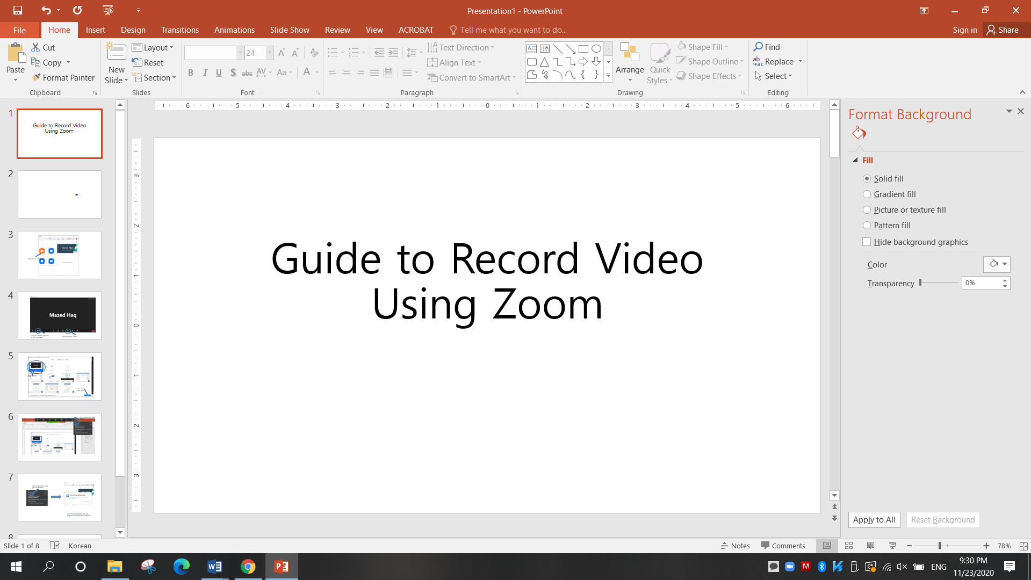
Open your PPT file

Slide 3
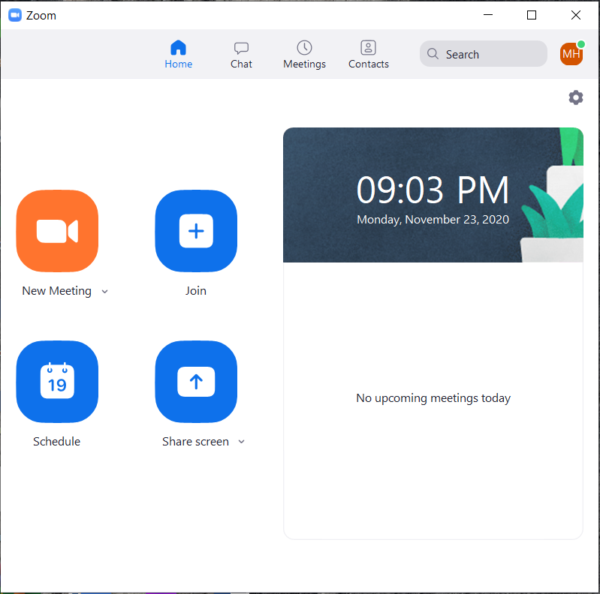
Open Zoom & Click on New meeting

Slide 4
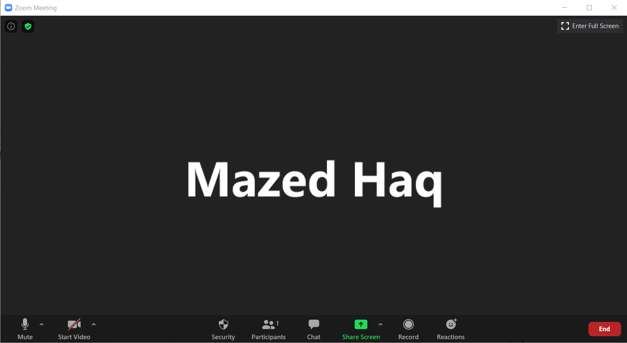
You can disable video as it is not required
Click on Share Screen

Slide 5
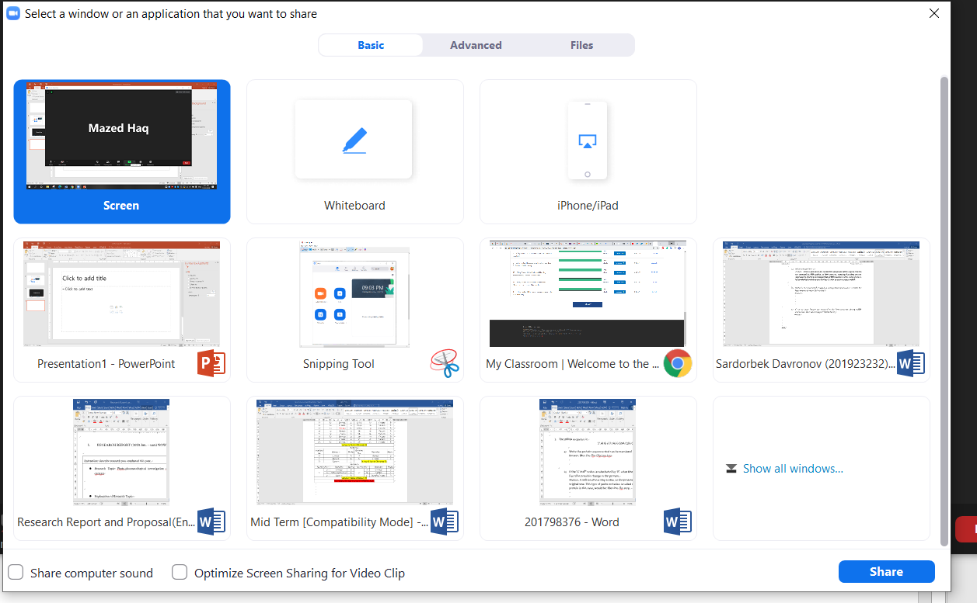
Select Screen
Click share

Slide 6
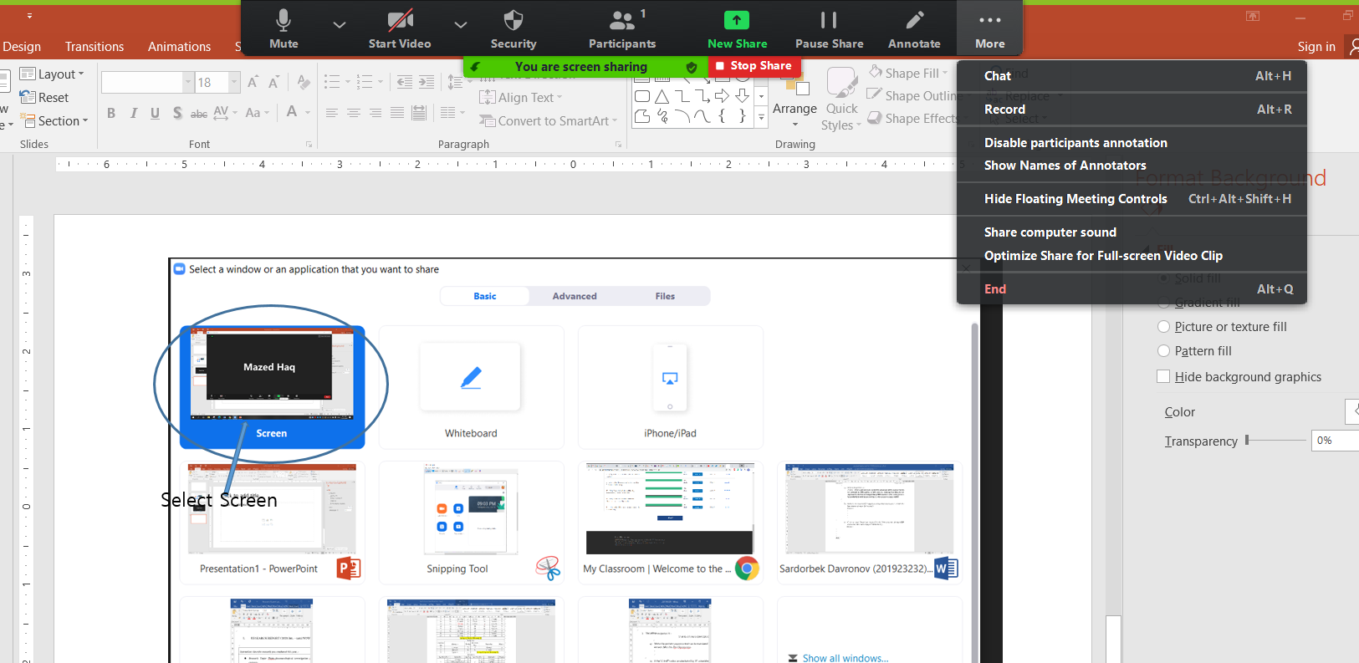
Start your Slide Show
Go to more and click record

Slide 7
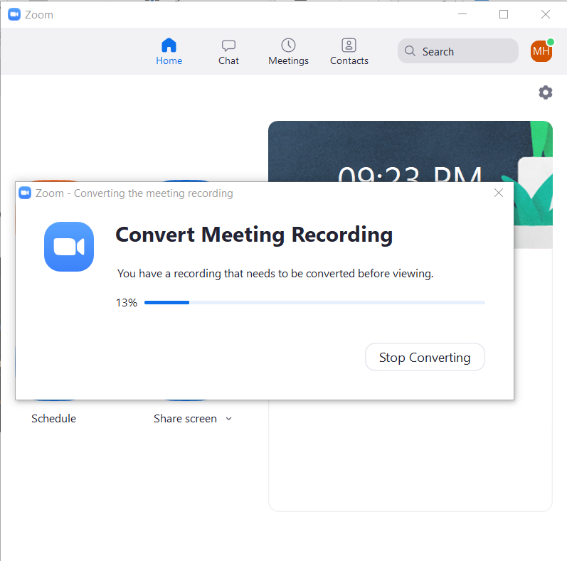
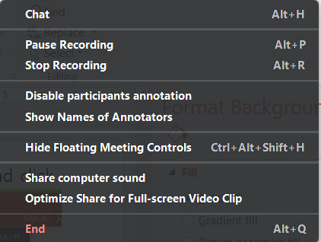
Click stop record when you are finished
After ending meeting this will appear, let it finish the conversion

Slide 8
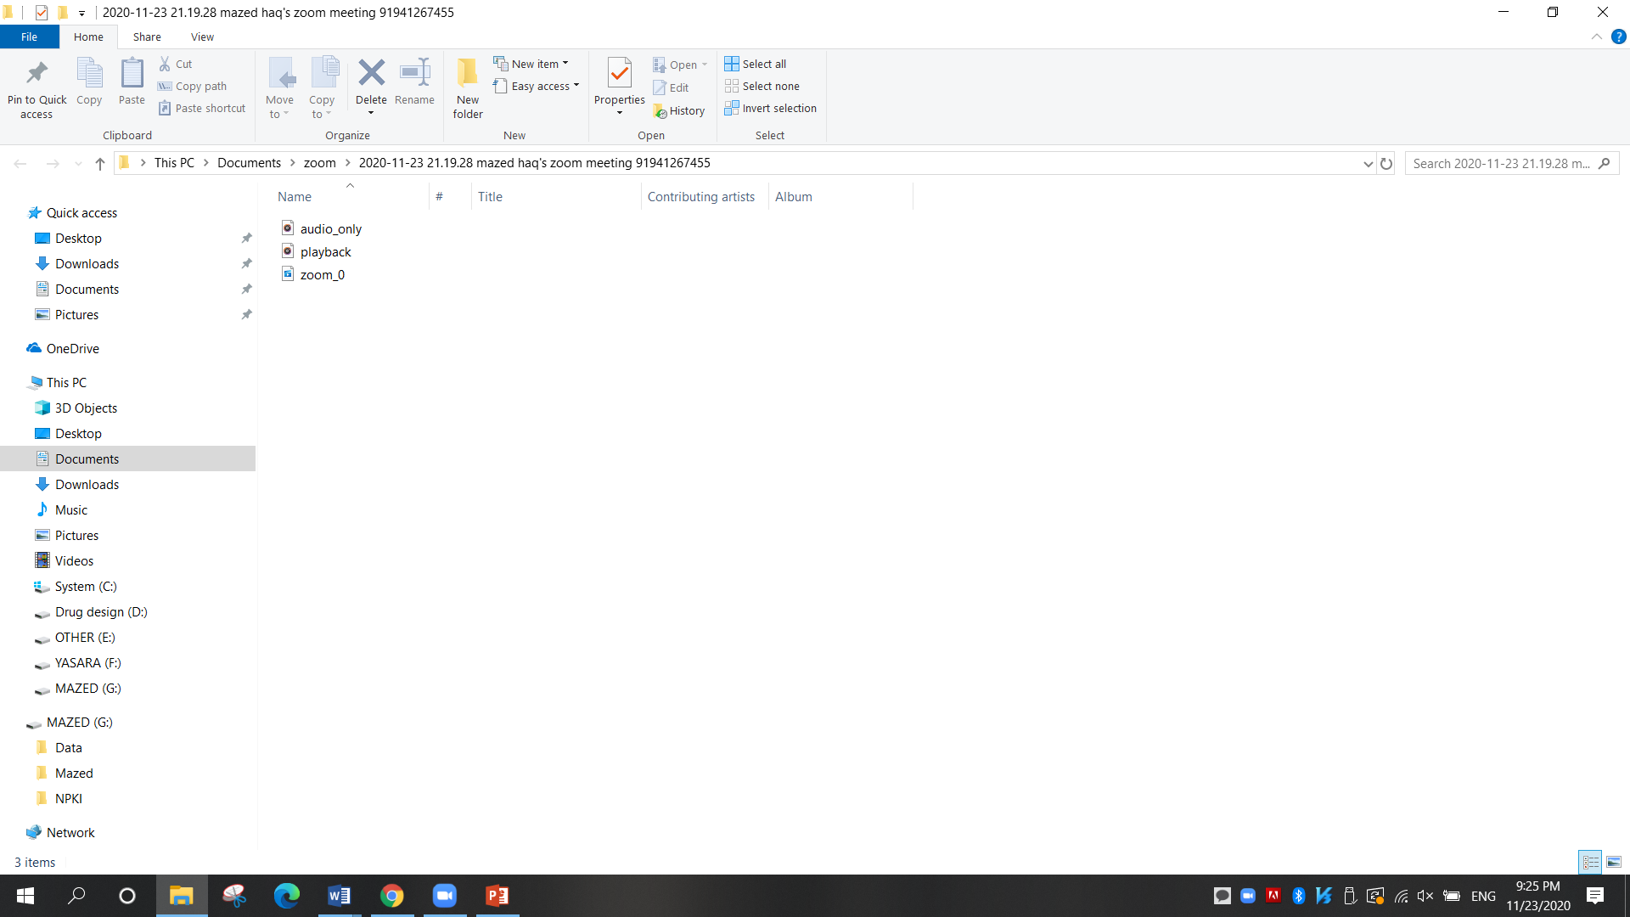
Change the file name as your topic title and upload to the LMS
After conversion it will automatically open the file directory containing the video file.

Slide 9
THANK YOU

